Slide 1
Smart Devices
From Theory to prototype
Chris Harrold - @charrold303

Slide 2
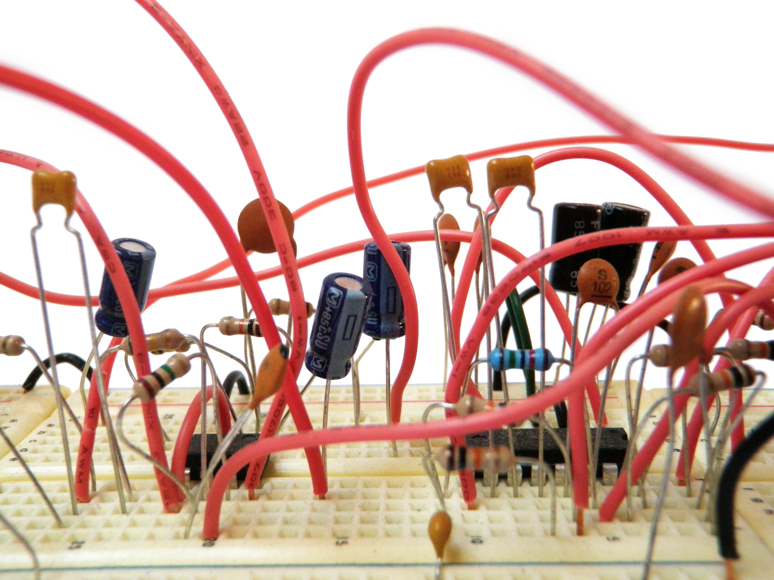
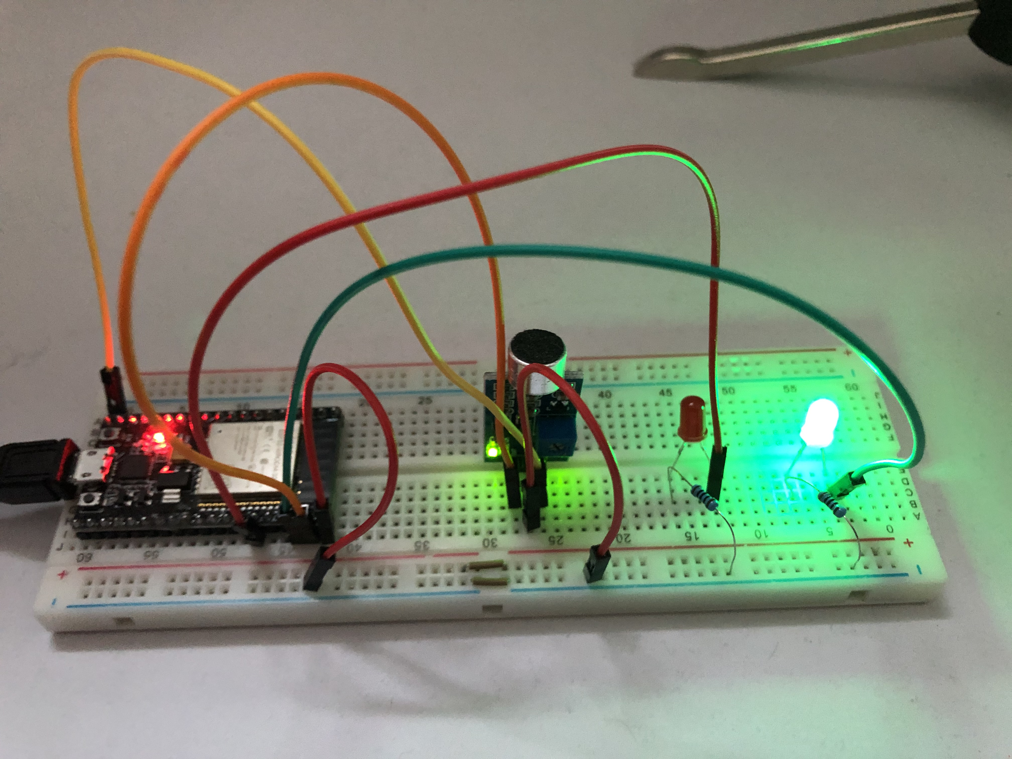
Who and what?
ANYONE WHO IS PI-CURIOUS
HARDWARE TIPS FOR STARTING OUT

Slide 3

Things TO JUST KNOW
Theory for practice

Slide 4
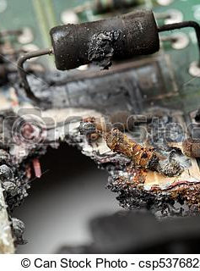
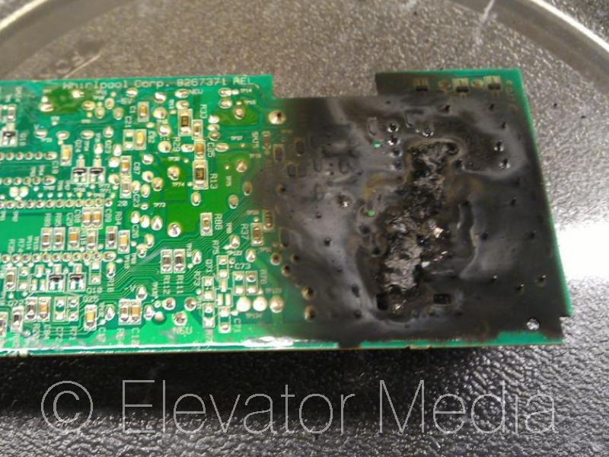
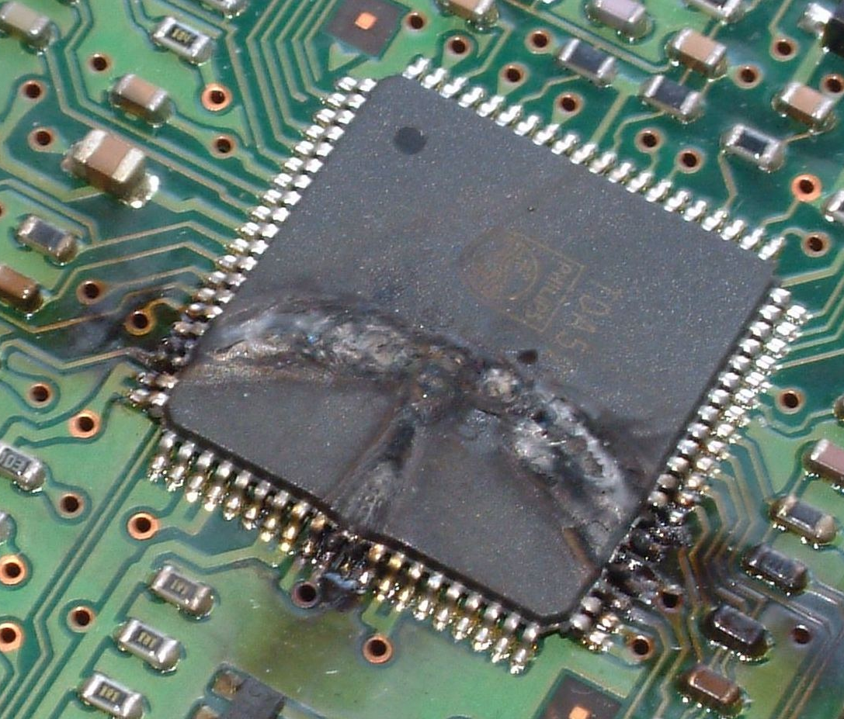
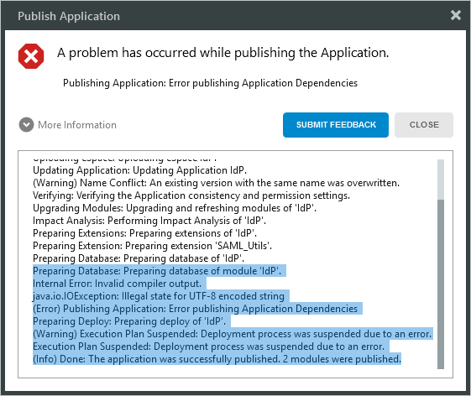

Root Cause
Software errors are “soft”
Hardware errors on the other hand….
ELECTRICITY KILLS PEOPLE!
Notes:
Getting over working with hardware

Slide 5
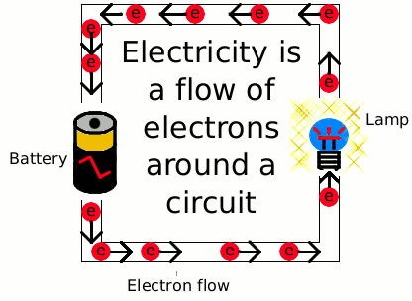
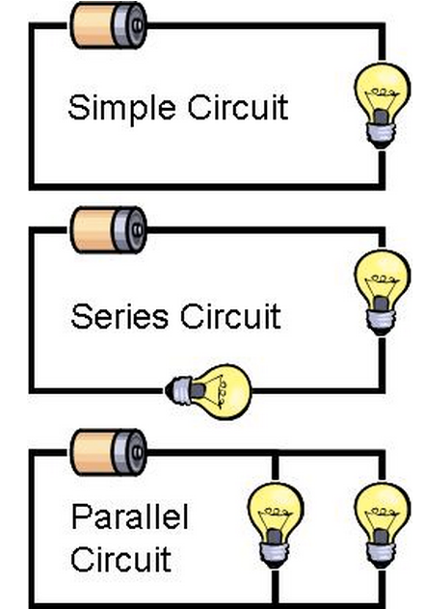
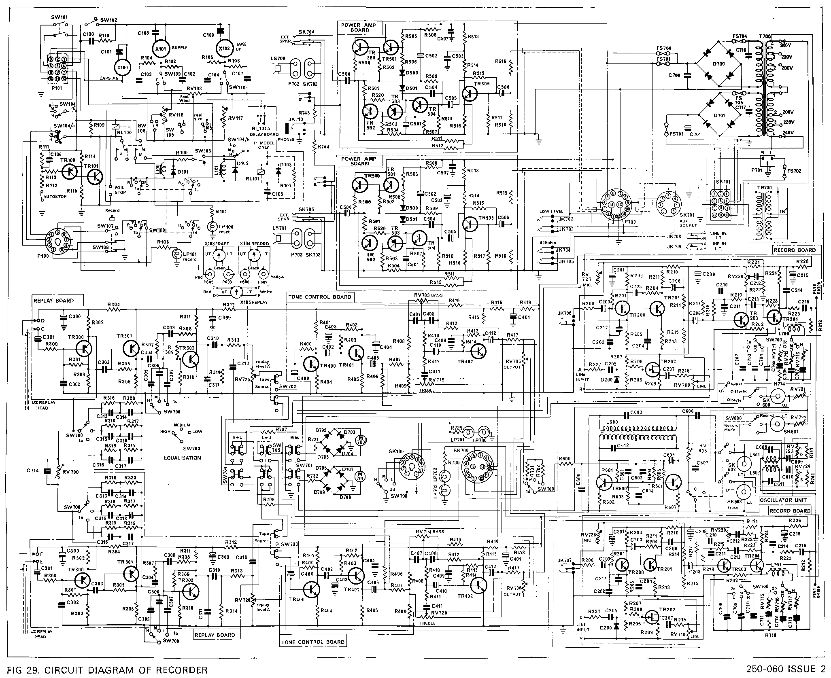
How electricity works
Electricity is electrons flowing from one point to another
The path it takes is called a circuit – there are a few types
When you build smart devices, you are assembling circuits
Notes:
Depending on your POV, it flows from – to + (physics) or from + to – (EE)
There are 3 basic circuits: simple, series, parallel
Lots of circuits together makes something that does something

Slide 6
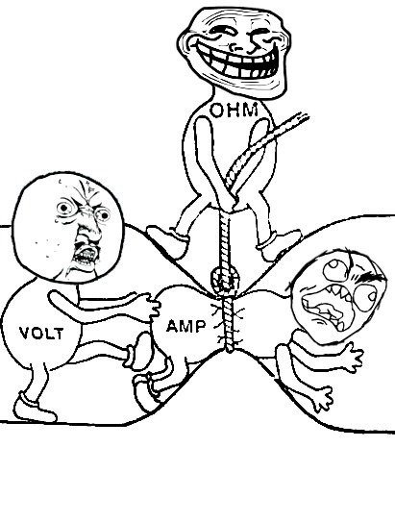

Electrical Flow:
The force of electrical flow is measured in: VOLTS
The rate of flow of the electricity is the CURRENT and is measured in:
AMPERES (AMPs for short)
The amount of restriction on the flow is RESISTANCE and is measured in:
OHMS – (symbol is $Ω$)

Slide 7
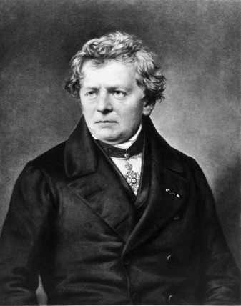

OHM: The O-G of EE And His Law
Electrical flow is governed by:
Ohm’s Law
V=IR OR I=V/R OR R=V/I
Voltage (V)
Current (I)
Resistance (R)
V
I
R
Notes:
Ohm did his work on resistance in the years 1825 and 1826, and published his results in 1827 as the book Die galvanische Kette, mathematisch bearbeitet ("The galvanic circuit investigated mathematically").[

Slide 8

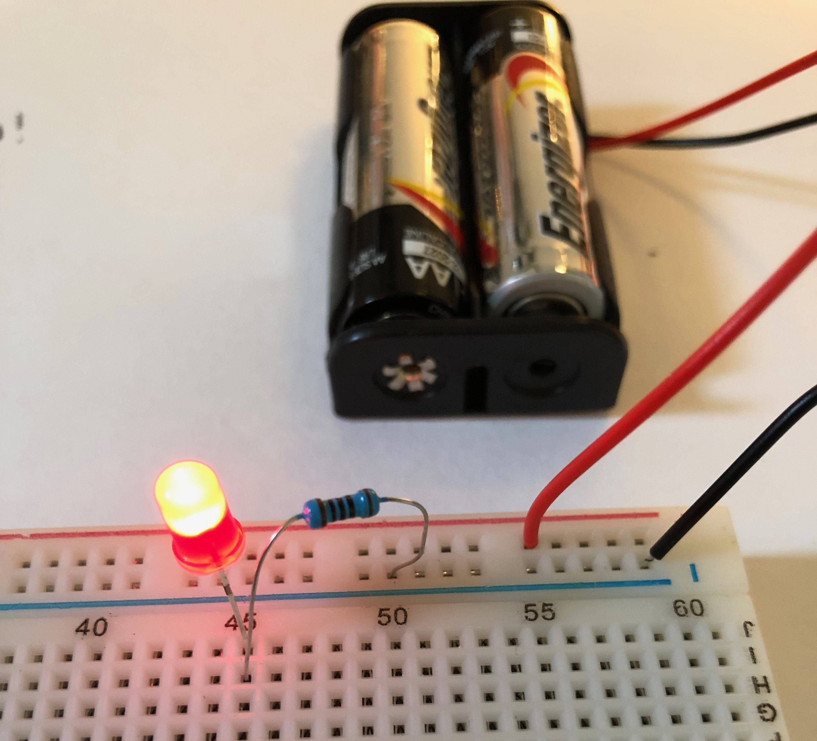
Ohm in Action!
3 VOLTS total power
LED needs 20mA (milliamps) and “consumes” about 1.8 volts
How much resistance do you need?
R = V/I
R = (3-1.8)/.020
R=1.2/.020
R= 60 Ohms
Notes:
There is no 60 ohm resistor – but you should always use the closest without going under, so 68 in this case is the right answer – if you use larger it will still work, up to a point at which the resistance is too high and no current will flow (or so little that the light will stay unlit)

Slide 9
A quick Demonstration
Of getting it wrong!

Slide 10
I wish someone told me
How to get to a prototype

Slide 11
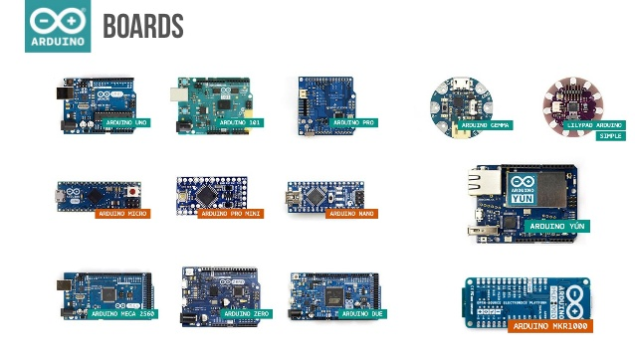
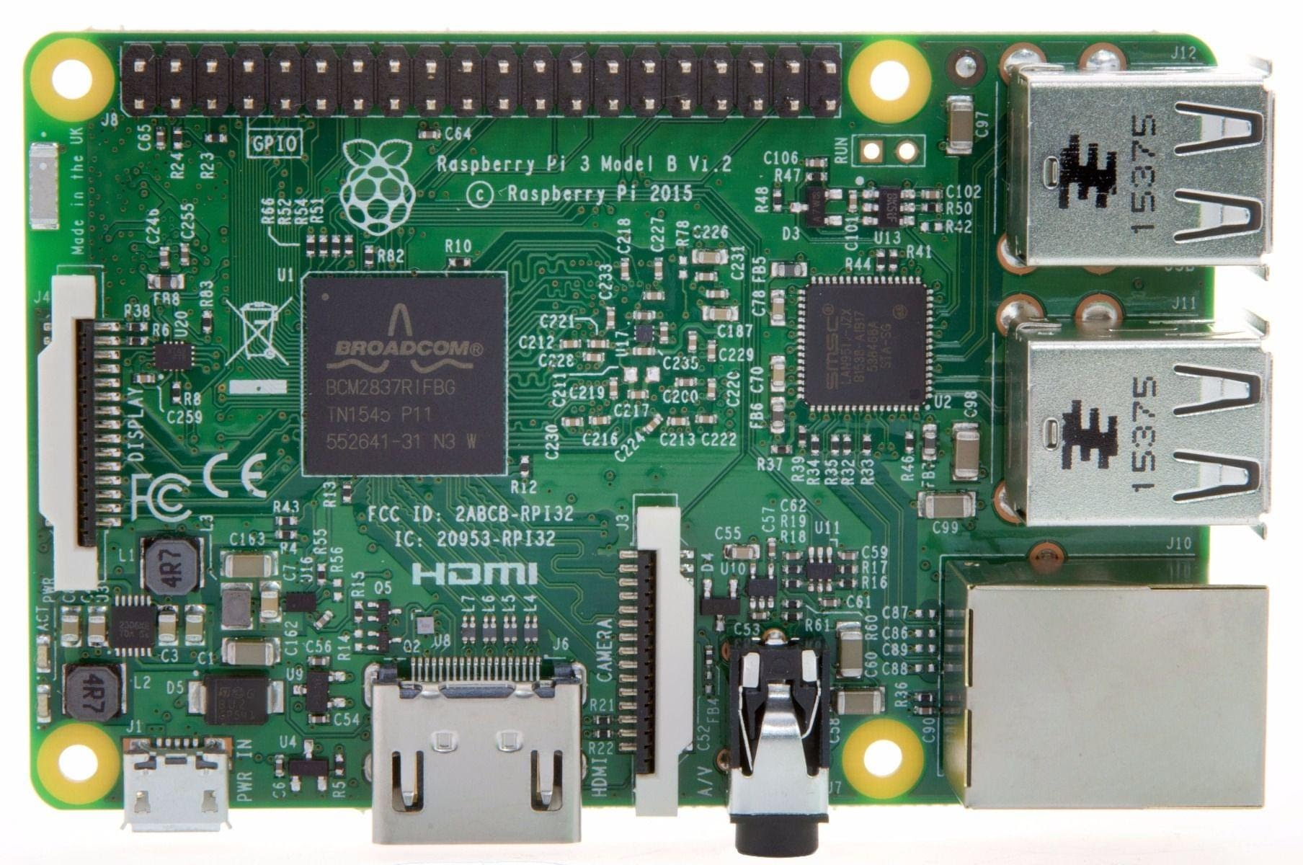
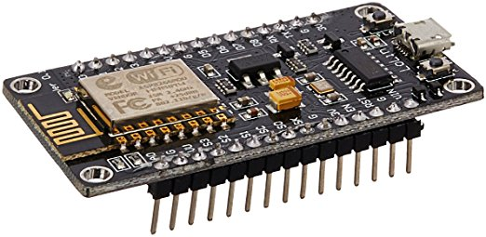
Which platform for which project?
Arduino and Compatible
Raspberry Pi
One “task” only
Very light on resources
Native analogue and digital
Full computer – run multiple things
Full computer – uses full resources
Digital only (analogue with helpers)
Notes:
Arduino
Can read from and poll multiple sensors, but only runs one program at a time
R-Pi is a full computer and everything that comes with that from bloat and power use to complexity and increased abilities

Slide 12
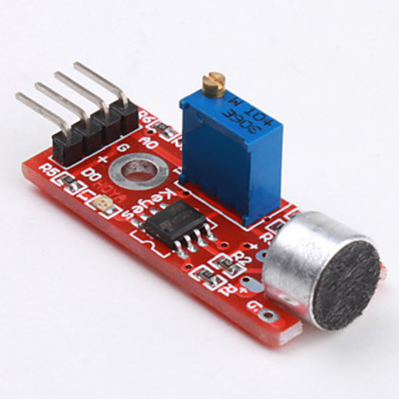
Analogue vs Digital (GENERALLY)
Analogue
Digital
The amount of a thing as an amount of voltage
Is there the thing, yes or no?
Data packets of information about the thing

Slide 13
“pro(totype) tips”
Consider Debug and override modes
Visual indicators – yes or no
Output and reporting of data
Use simple circuits for great success!
One function for one function
Build apart and integrate at the end

Slide 14
The C.R.A.P. Method
C.onceive
R.esearch
A.cquire
P.rototype

Slide 15
The new device checklist:
Where will it be?
What am I measuring?
How often do I want to measure it?
Do I have access to electricity?
Do I have access to a wired/wireless/cellular network?
Is this for fun, or will something/someone’s life depend on it?
http://www.github.com/ChrisHarrold/NewDeviceChecklist

